Slide 1
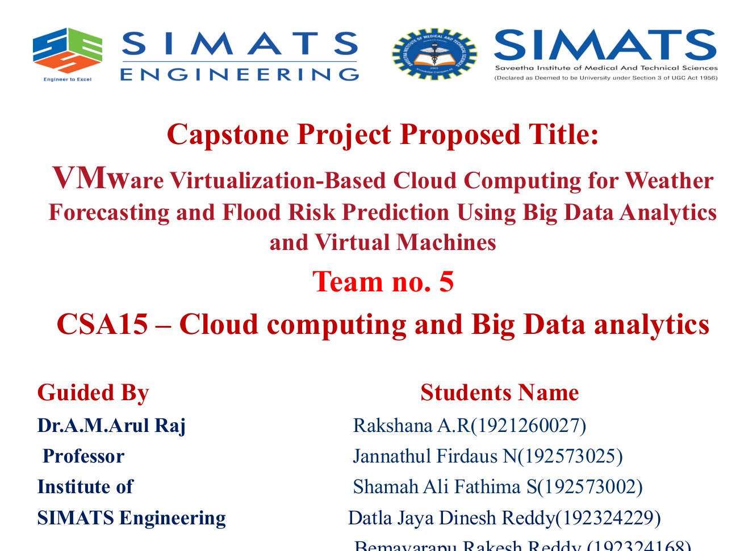

Slide 2
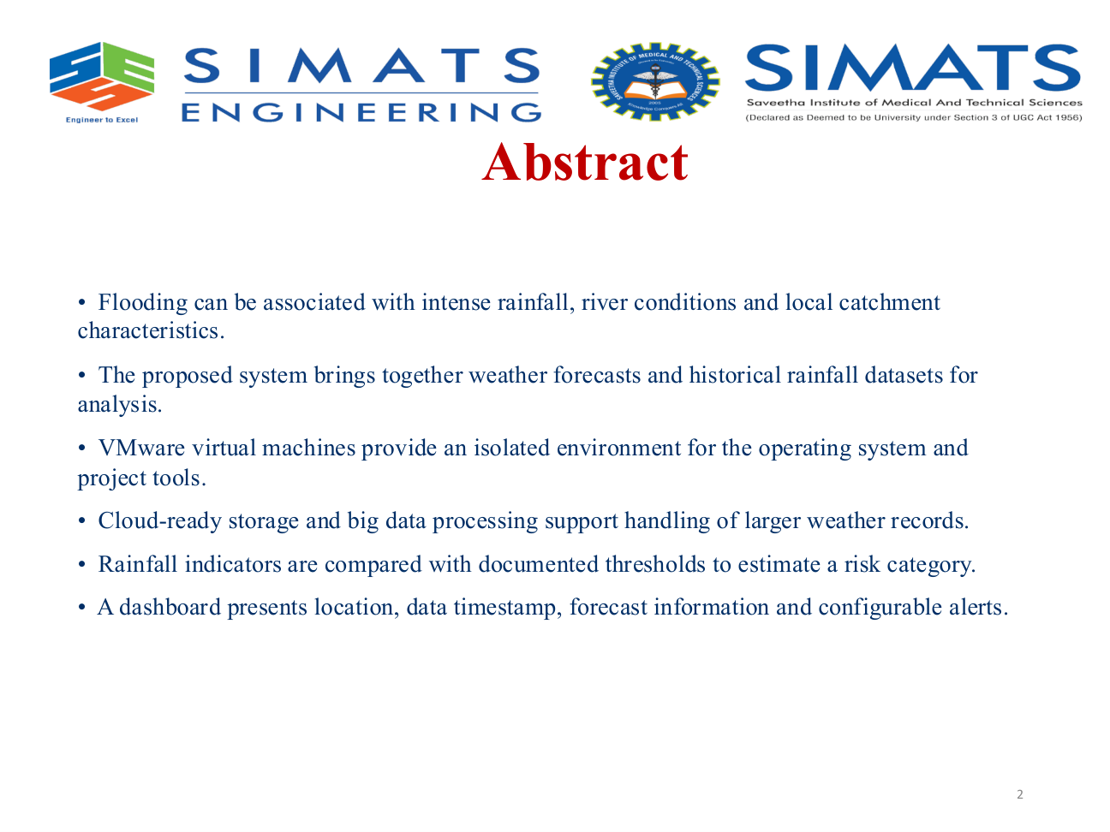

Slide 3
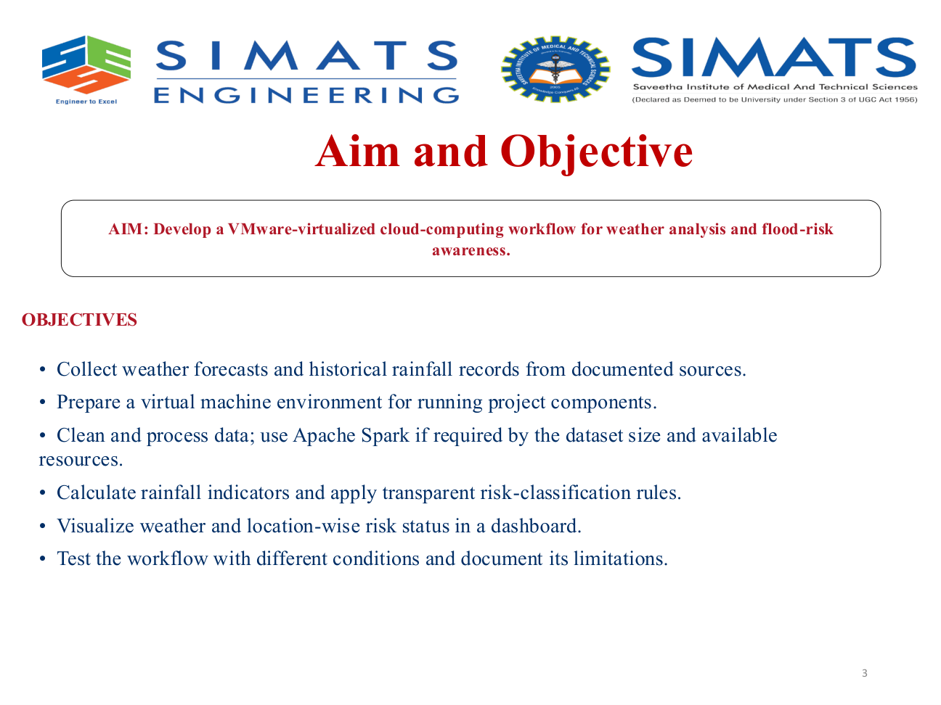

Slide 4
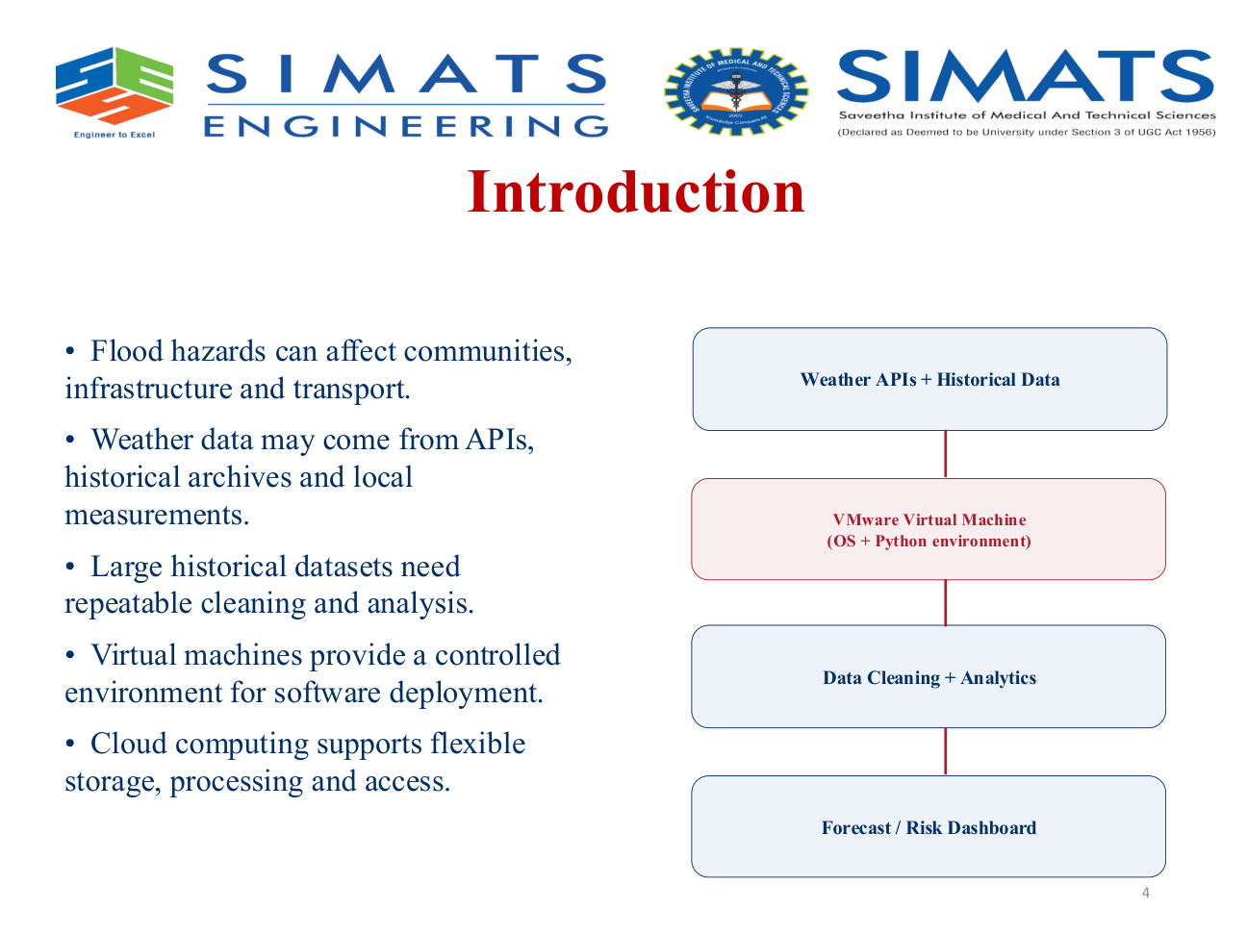

Slide 5
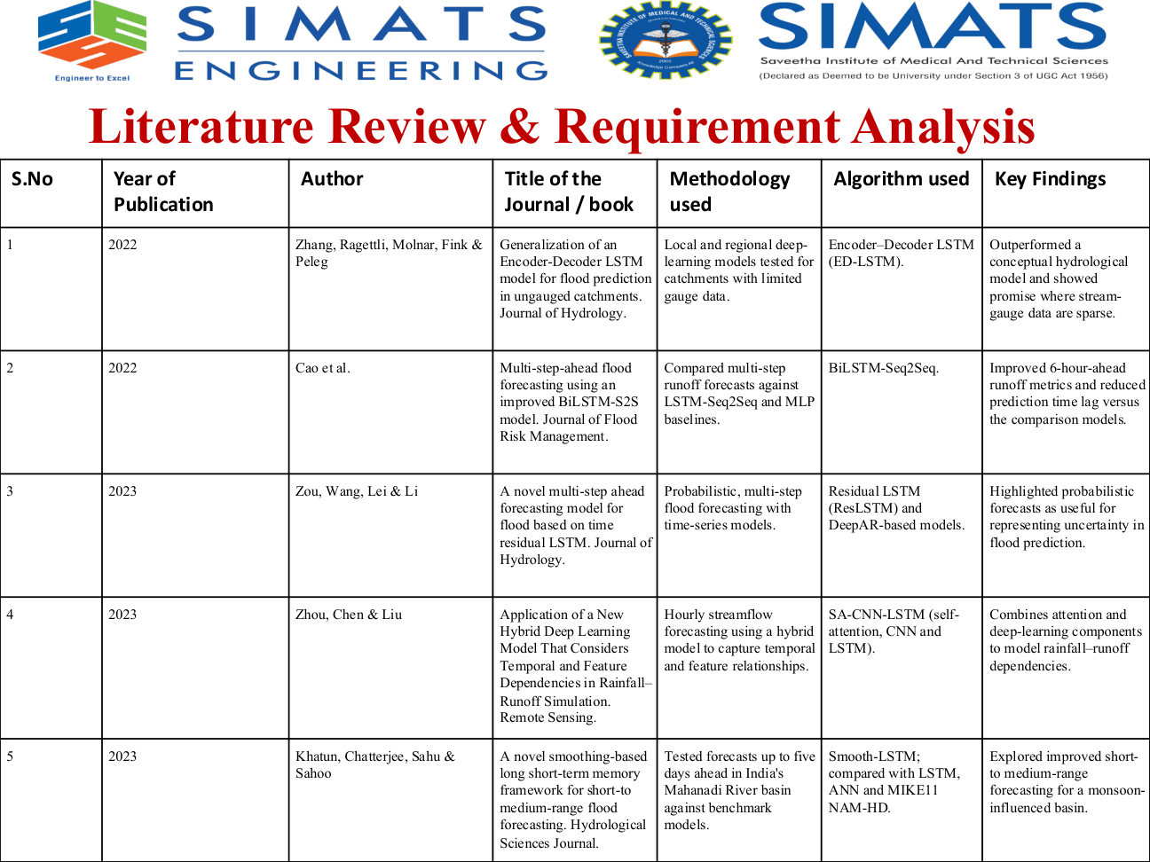

Slide 6
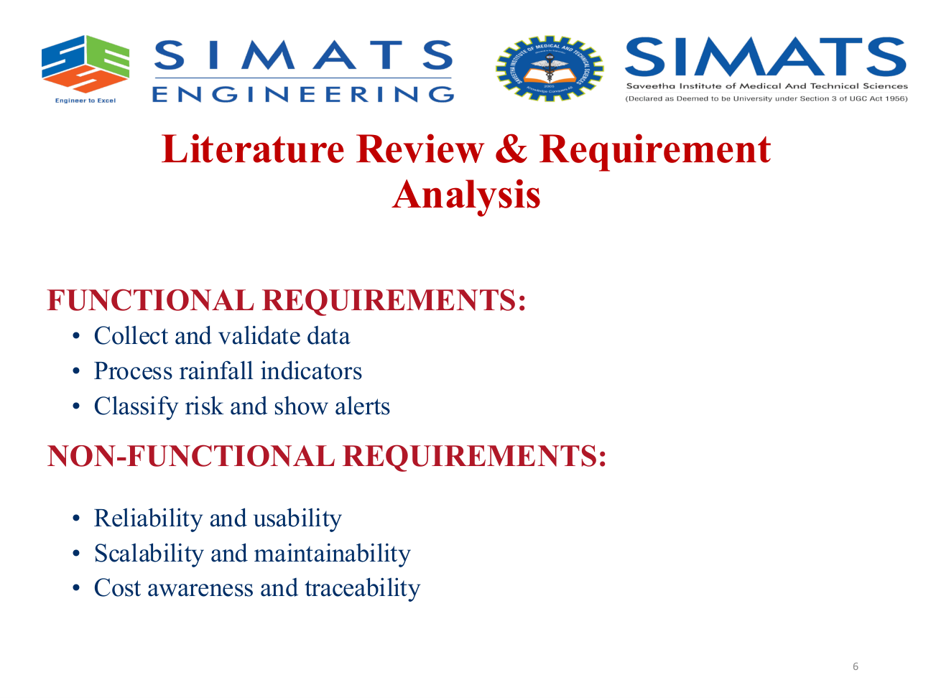

Slide 7
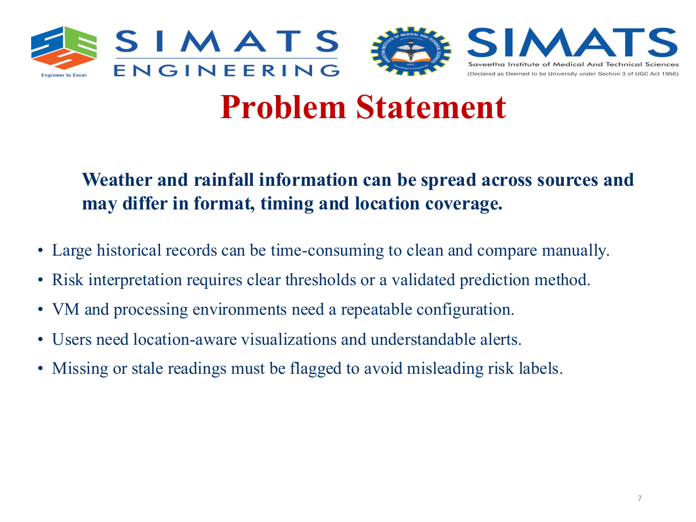

Slide 8
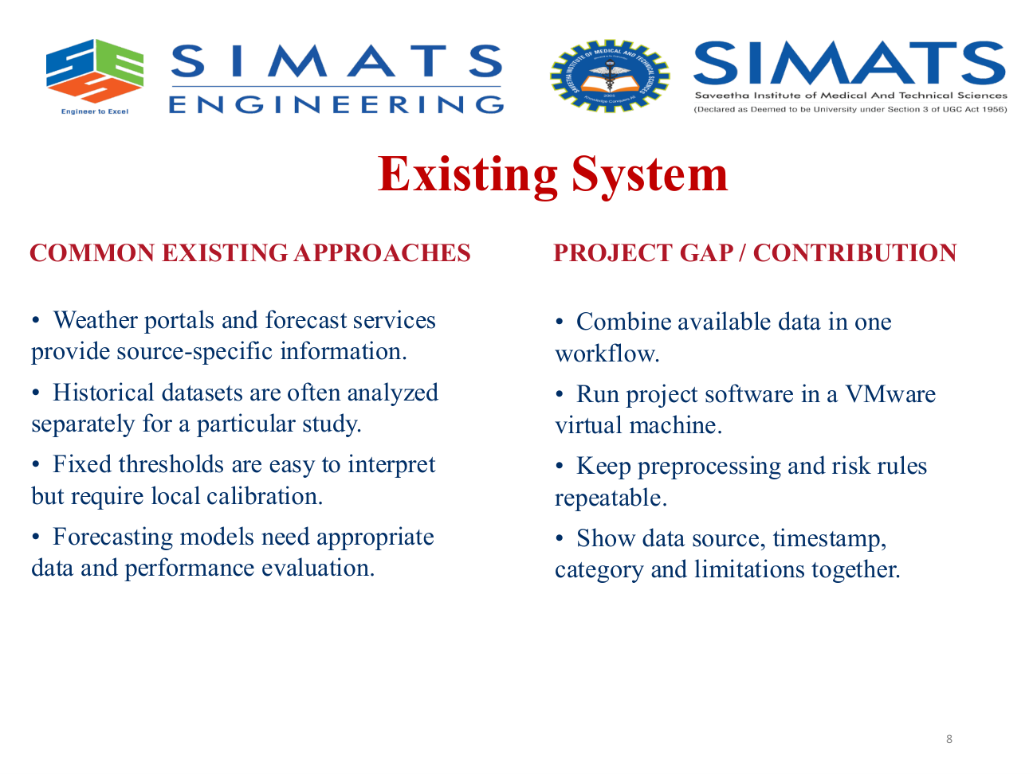

Slide 9
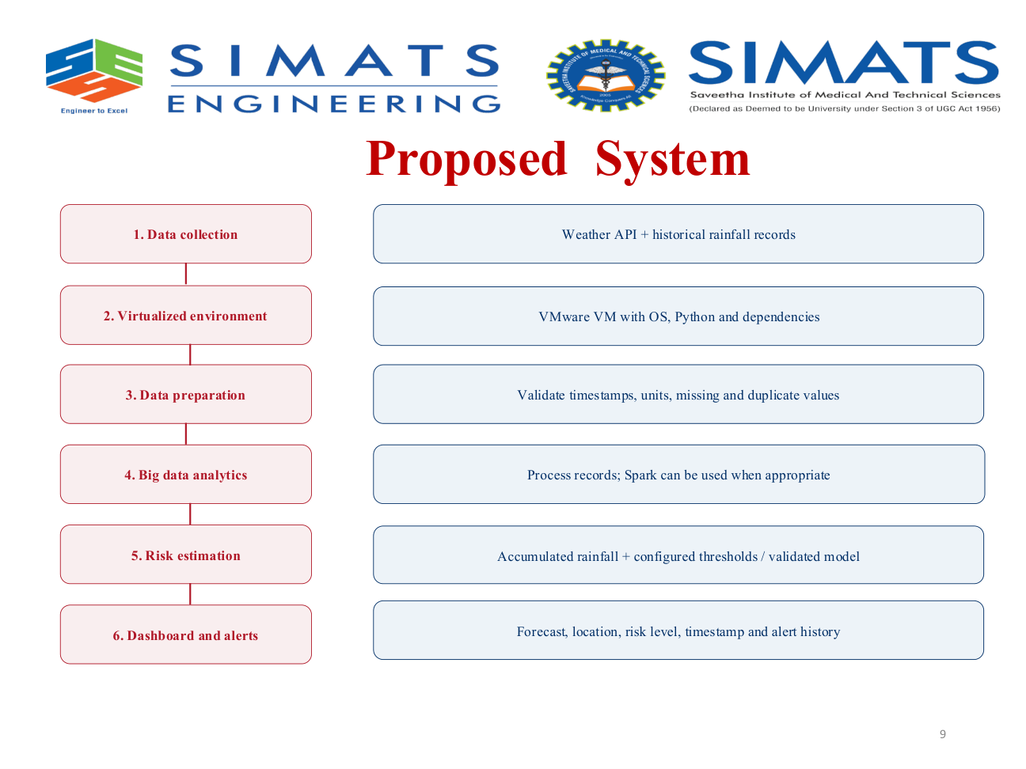

Slide 10
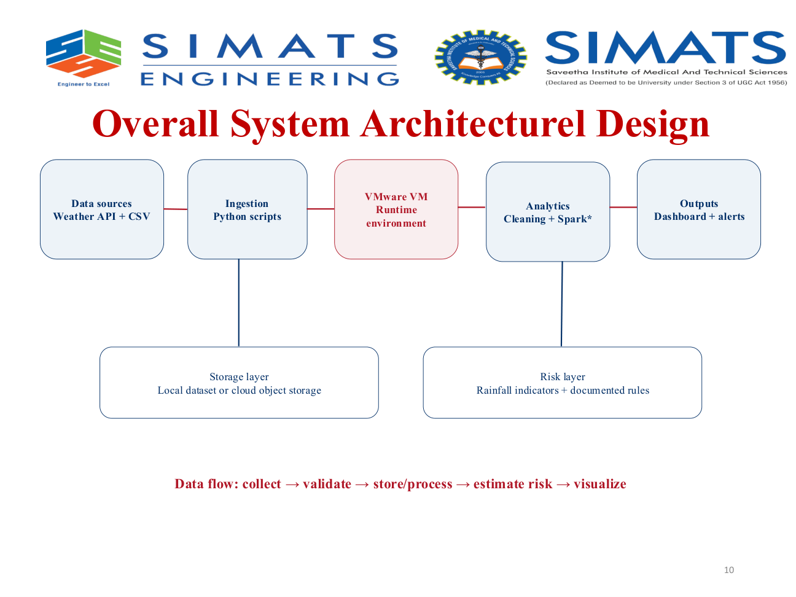

Slide 11
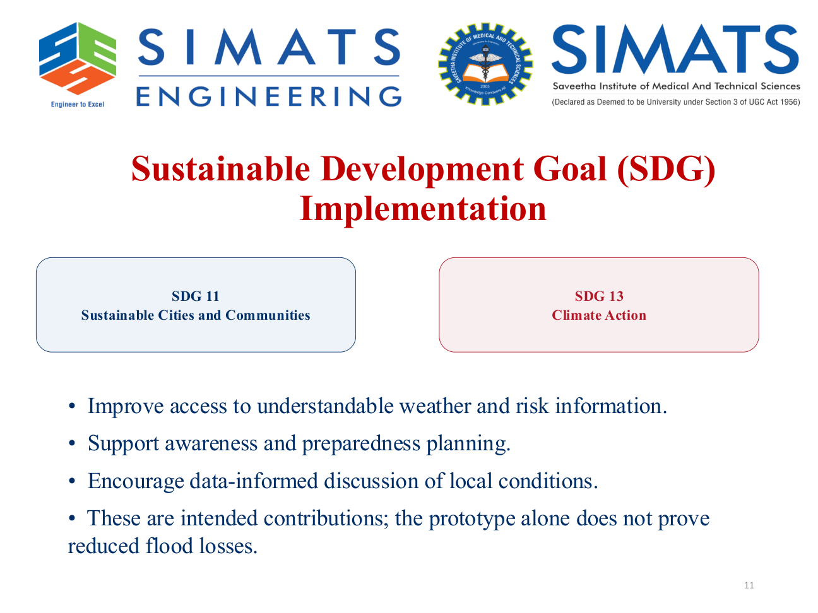

Slide 12
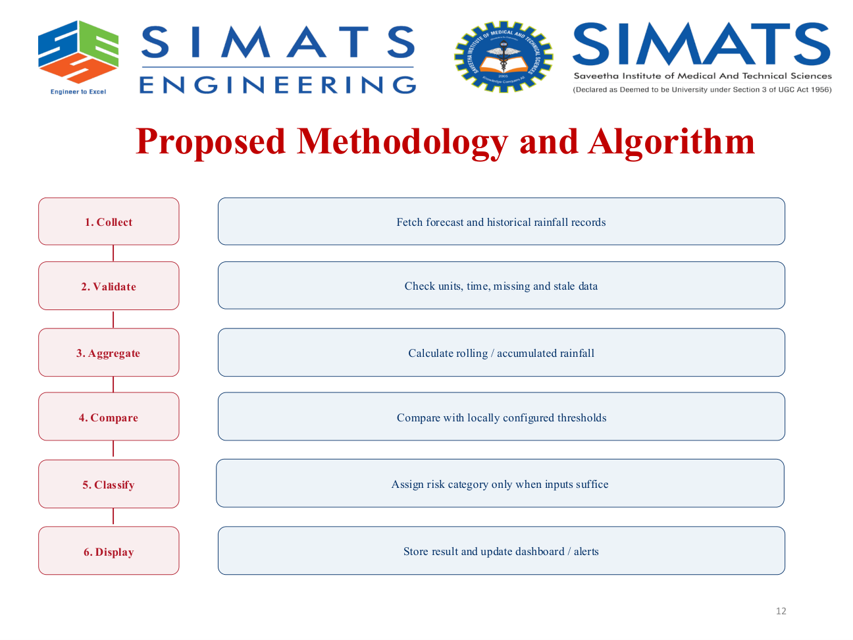

Slide 13
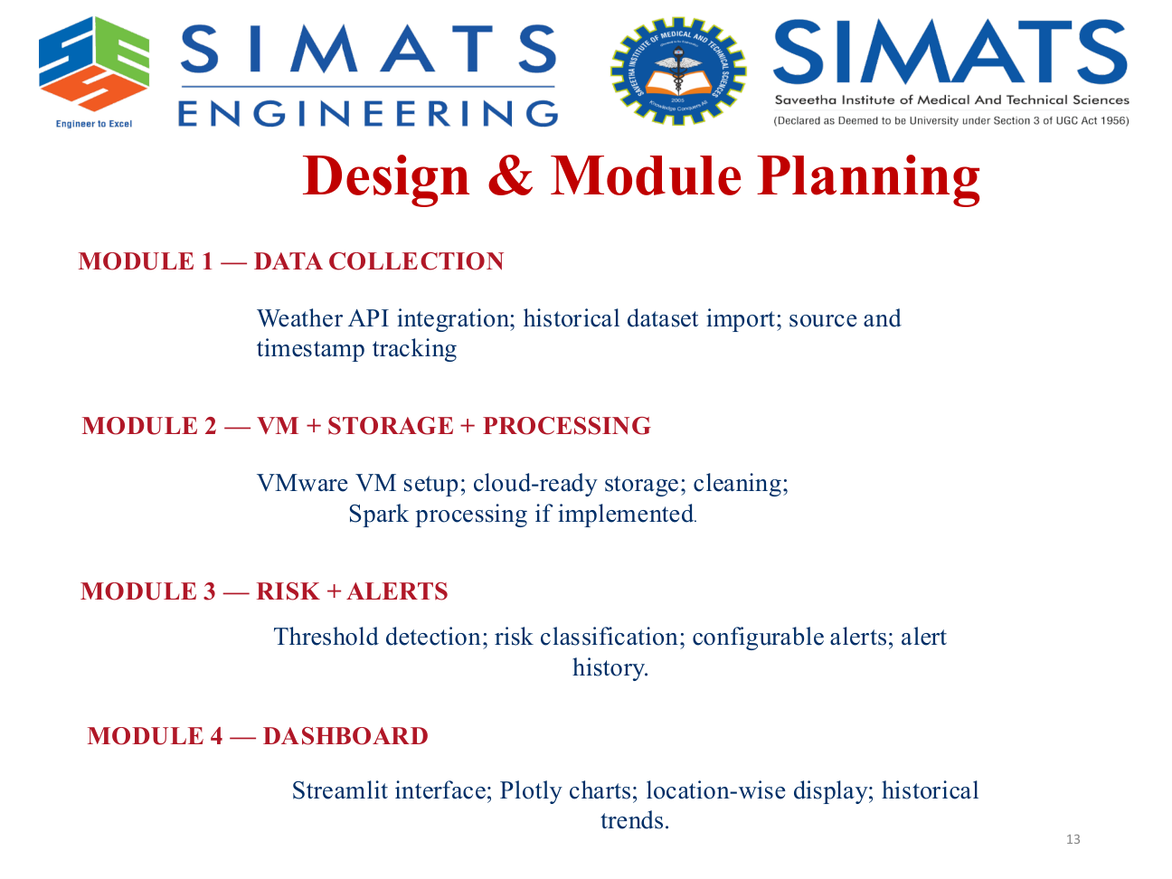

Slide 14

Module-1
Integration with public weather APIs (e.g., Open-Meteo)
Collection of rainfall, temperature, humidity and weather conditions
Import of historical rainfall datasets for trend analysis
Capture of location and timestamp information
Validation of missing, duplicate and invalid records
Transfer of cleaned weather data to the processing module

Slide 15
MODULE 2 — VM + STORAGE + PROCESSING
Use of a Virtual Machine (VM) to host the processing application
Storage of weather data in cloud storage or structured datasets
Preprocessing: cleaning, formatting and handling missing values
Use of Apache Spark for large-scale data processing
Calculation of accumulated rainfall over selected time intervals
Analysis of rainfall trends and comparison with configured thresholds

Slide 16
MODULE 3 — RISK + ALERTS
Evaluation of accumulated rainfall and configured risk thresholds
Classification of flood risk into Low, Moderate, High and Severe
Detection of rainfall threshold violations
Generation of alerts when risk levels increase
Recording of alert details, timestamps and affected locations
Support for configurable thresholds and alert conditions

Slide 17
MODULE 4 — DASHBOARD
Development of an interactive dashboard using Streamlit
Visualization of rainfall data using charts and graphs
Display of current weather conditions and flood-risk levels
Location-based presentation of risk information
Historical rainfall trends and threshold comparisons
Display of active alerts and alert history

Slide 18
MODULE 5 — TESTING + PERFORMANCE EVALUATION
Testing weather API connectivity and data collection
Verification of data cleaning and processing accuracy
Testing rainfall threshold-based risk classification
Validation of alert generation for different risk levels
Evaluation of dashboard functionality and data updates
Measurement of processing time and system responsiveness
Identification of limitations and possible improvements

Slide 19
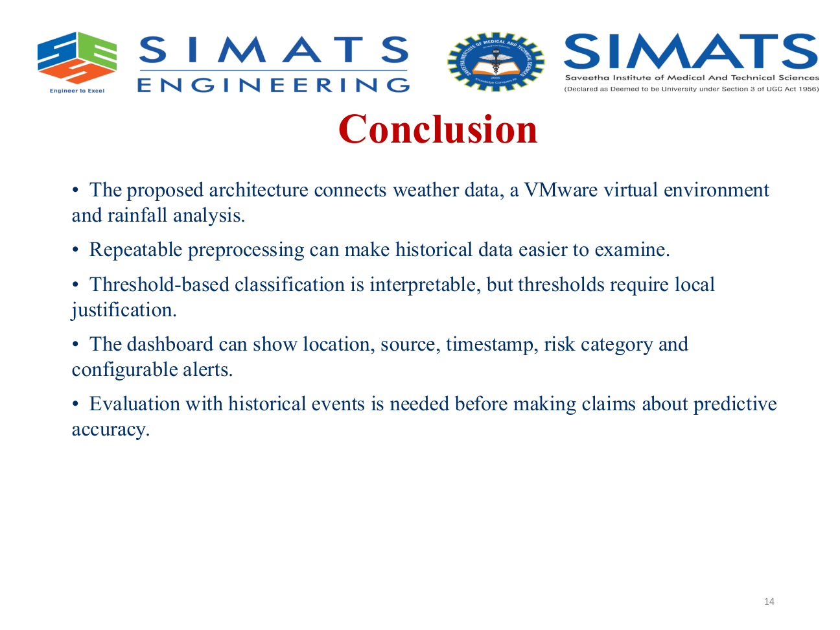

Slide 20
